Slide 1

Statistics for Data Science

Slide 2

What is Statistics ?
Statistics is simply the study of data, facts, figures and measurements. Statistics is used to convert raw numerical data into useful information for relevant users.

Slide 3





Some examples of how statistics shape our life
Weather Forecast
Stock Markets
Predicting emergencies
Political Campaigns
Insurance
Medical Studies
Genetics

Slide 4
Worksheet

Slide 5
Some statistical statements
I drive my car at an average speed of 50 km/hr.
A survey of 1000 adults by a capital markets company showed that 75% of adults think that Corona vaccine is 96% efficacy (if that is the case then 4% of people can die)
We will close the quarter higher at 120% attainment ( Actuals/Target)
20% of our workforce would resign by the end of next year
So, you can challenge most of the statements here. But these statements will be applicable to most of the population but there can be exceptions.

Slide 6
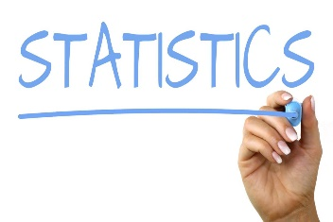
What is Statistics ?
Uncertainty is rampant ! we use statistics to answer questions about things that are unknown (e.g. : number of cars in Bangalore ?) , but just as importantly, we use statistics to get an idea of how sure we are of our answers. Sometimes it is useful to know that you don’t know.!!
Statistical tools are used to make most out of limited information!!

Slide 7
Terminology commonly used terminology in the discipline of statistics
Variable : A variable is defined as an attribute of an object of study. Choosing which variables to measure is central to good experimental design.
Ex : You are collecting data of weight of adults of male living in Australia, here our variable is weight
A Variables are things you measure, manipulate and control in statistics and research.
All studies analyze a variable, which can describe a person, place, thing or idea. A variable's value can change between groups or over time.
A variable can also be called as a data item
Another example : if the variable in an experiment is a person's eye color, its value can change from brown to blue to green from person to person.

Slide 8
Types of Variables
Variable
Quantitative
Qualitative
Discrete
Continuous
Nominal
Ordinal
Binary
Ex:

Slide 9
Quick exercise – Identify type of Data

Slide 10
Worksheet

Slide 11
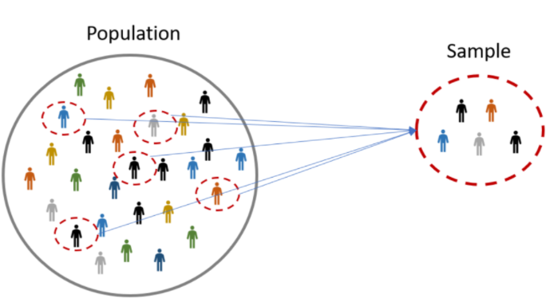


Population & Sample
A population is the collection of all items of interest to our study and is usually denoted with an uppercase N.. The numbers we've obtained when using a population are called parameters..
A sample is a subset of the population and is denoted with a lowercase n and the numbers we've obtained when working with the sample are called statistics.
Example : Let's say we want to perform a survey of the job prospects of the students studying in the New York University, what is the population?

Slide 12
Worksheet

Slide 13
Why Sample should be Random & Representative?
Sampling involves selecting units from a population of interest such that the sampling units represent the whole population. If sample is bias the resultant statistics can bias and will not be representative.
Random sampling is one such procedure that selects a sample of units from a population by chance, typically to facilitate generalization from the sample to the population.
Random sampling ensures that results obtained from your sample should approximate what would have been obtained if the entire population had been measured. The simplest random sample allows all the units in the population to have an equal chance of being selected. Often in practice we rely on more complex sampling techniques.

Slide 14
Bias in sampling :
There are five important potential sources of bias that should be considered when selecting a sample, irrespective of the method used. Sampling bias may be introduced when:
Any pre-agreed sampling rules are deviated from
People in hard-to-reach groups are omitted
Selected individuals are replaced with others, for example if they are difficult to contact
There are low response rates
An out-of-date list is used as the sample frame (for example, if it excludes people who have recently moved to an area)
Types of Sampling :
Probability sampling involves random selection, allowing you to make strong statistical inferences about the whole group.
Non-probability sampling involves non-random selection based on convenience or other criteria, allowing you to easily collect data.

Slide 15
Worksheet

Slide 16
After understanding Population and Sample it opens the gate to understand what is Inferential and Descriptive statistics.

Slide 17
Inferential Statistics
The methods used to determine something about a population on the basics of a sample.
Inferential statistics allow you to test a hypothesis or assess whether your data is generalizable to the broader population.
Examples :
you want to know what factors can influence the decline in poverty. You use variables such as road length, economic growth, electrification ratio, number of teachers, number of medical personnel, etc.
We often hear the assumption that female students tend to have higher mathematical values than men. Is that right?

Slide 18
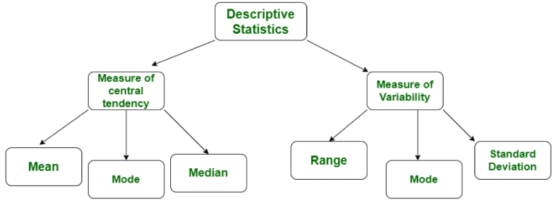
Descriptive Statistics
Descriptive statistics is a term given to the analysis of data that helps to describe, show and summarize data in a meaningful way. It is a simple way to describe our data.
Descriptive statistics is very important to present our raw data in effective/meaningful way using numerical calculations or graphs or tables. This type of statistics is applied on already known data.
Types of Descriptive Statistics
Measure of Central tendency
Measure of Variability
Examples :
you want to know what factors can influence the decline in poverty. You use variables such as road length, economic growth, electrification ratio, number of teachers, number of medical personnel, etc.
Variance

Slide 19
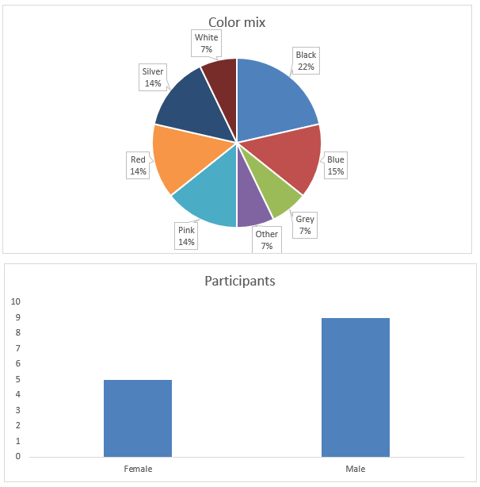
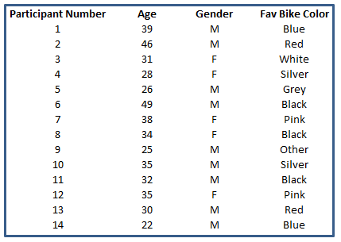
Descriptive Statistics – Example You’ve performed a survey to 40 respondents about their favorite car color. And now you have a spreadsheet with the results.
Descriptive statistics simply describes the data

Slide 20
Difference between Descriptive & Inferential Statistics

Slide 21
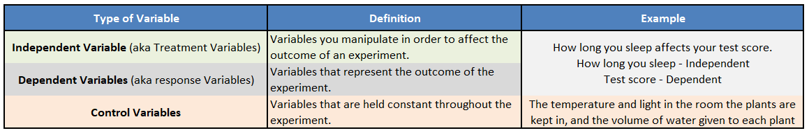
Independent, Dependent & Control variable
Importance of the Control Variables
Although control variables may not be measured as they are not recorded, yet they can have a significant effect on the outcome of an experiment.
Therefore, the lack of awareness of control variables may lead to faulty results or what is called “confounding variables”. So, recording control variables makes it easier to reproduce an experiment and to establish the relationship between the independent and dependent variables.
For example, suppose we are trying to determine whether a particular fertilizer influences plant growth. Here, the independent variable is the presence or absence of the fertilizer, whereas the dependent variable is the height of the plant or rate of growth.
If we don’t control the amount of light, for example, we perform some part of the experiment in the summer and some part during the winter, we may skew our results.

Slide 22
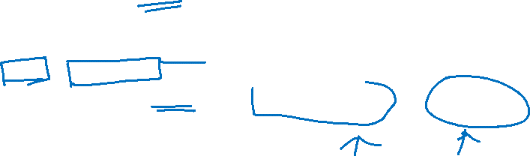
Types of Statistical Studies
When we talk about using data to learn something about the world, we are usually talking about performing a study or an experiment
In general, there are two types of statistical studies: Observational studies and Experiments
Statistical Studies
Observational
Study
Experiments

Slide 23

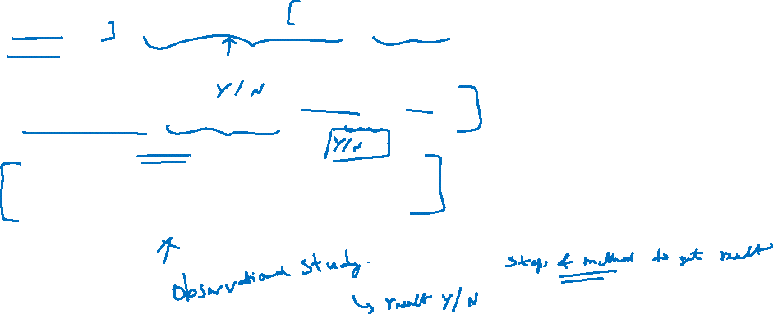
Understanding Observational Study & Experiment With an Example
Many students listen to music while studying. Does listening to music improve learning? Students in a statistics class decide to investigate this question.
Study 1 :
Do the majority of college students listen to music while they study? Do the majority of college students believe that listening to music improves their learning?
Survey Questions : Sent to all the students
Do you listen to music while you study?
Do you think listening to music improves your concentration and memory?

Slide 24

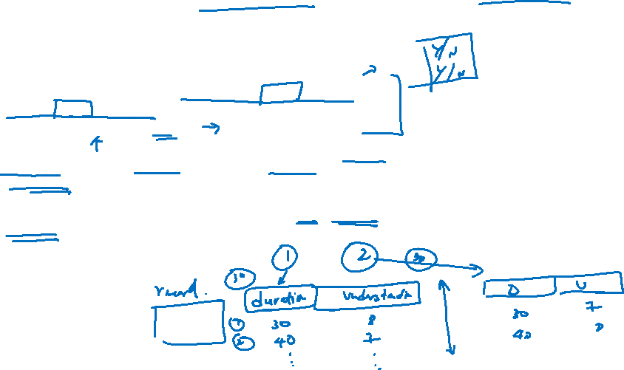
Understanding Observational Study & Experiment With an Example
Study 2 :
When we compare students who study with music to students who study in a quiet environment, which group gives higher ratings for understanding what they studied?
To investigate this question, the instructor divides the class into two groups: (1) those who listen to music when they study and (2) those who do not listen to music when they study. The students keep a journal for a week. Each time they study, they record the following information:
Length of study session (in minutes)
A rating of how well they understood what they studied, on a scale of 1–10: 1 = no understanding, 10 = excellent understanding.

Slide 25
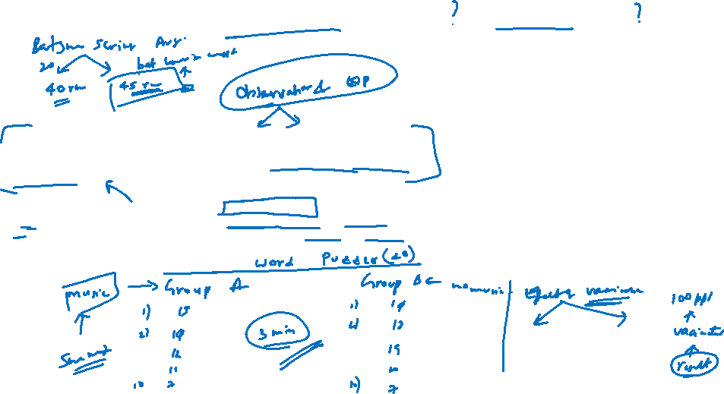
Understanding Observational Study & Experiment With an Example
Study 3 :
Does listening to music improve students’ ability to quickly identify information?
To investigate this question, the instructor uses word-search puzzles. She divides the class into two groups. Students on one side of the room do a word puzzle for 3 minutes while listening to music on an iPod. Students on the other side of the room do a word puzzle for 3 minutes without music. The instructor calculates the average number of words found by each group.

Slide 26

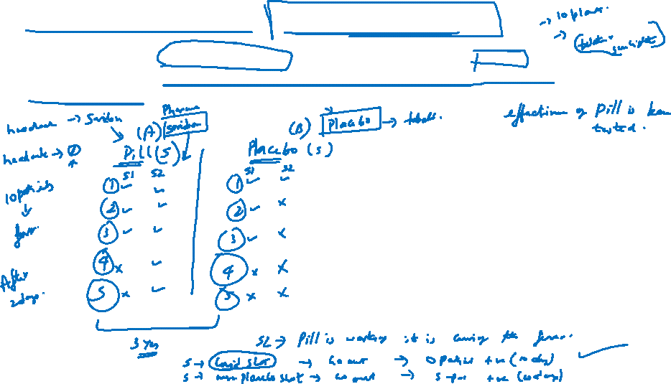
Control Experiment – drug test example
If we are studying the effectiveness of a pill, we should also compare it to a placebo. It is often the case that the act of receiving a treatment that a person believe will be beneficial with itself result in a beneficial effect. Regardless of whether the treatment is otherwise effective
This Photo by Unknown Author is licensed under CC BY-NC-ND

Slide 27
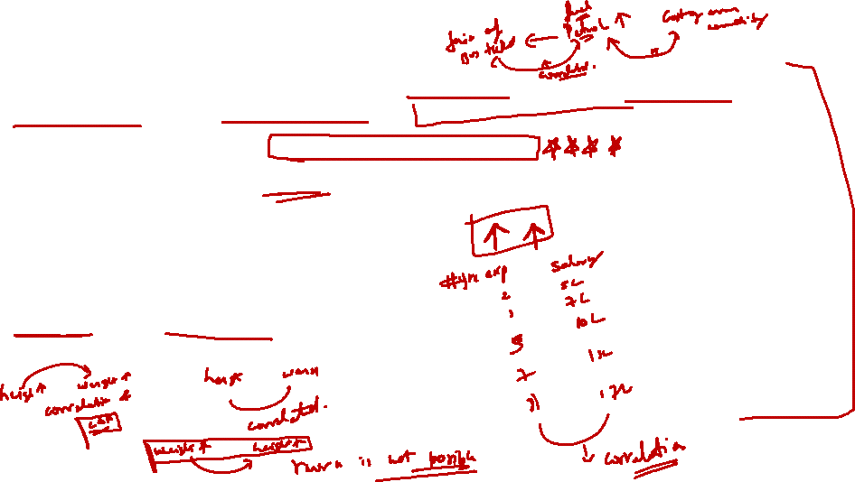
Controlled Experiment
In a controlled experiment, we can be reasonably comfortable inferring that the treatment applied to one group but not to the other caused whatever difference we observe between the two
But other we must remember that correlation does not imply causation
Variables are correlated if they “move together”, i.e when one variable changes the other one trends to change as well
Ex :
Temp is related to the time of the day
Human height correlated to human weight
When height increase human weight increase. When one variable change the other variable also changes. It can increase or decrease. Hence, I am using the word changes, this is called as correlation

Slide 28
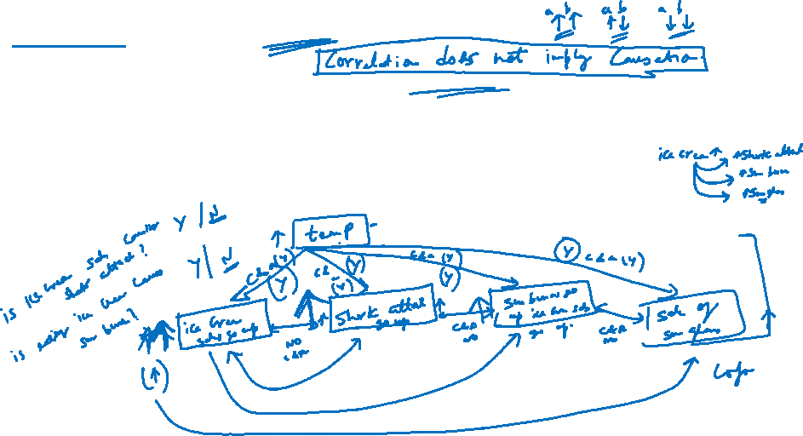
Correlation and Causation
If changing one variable caused a change in another, they will be correlated. But the converse is not necessarily true
If two variable are correlated, it is not necessarily the case that one has caused the other to change
For instance, Marriage & Income
It is said that people who are married make more money, But is it not true that more money can get people married

Slide 29
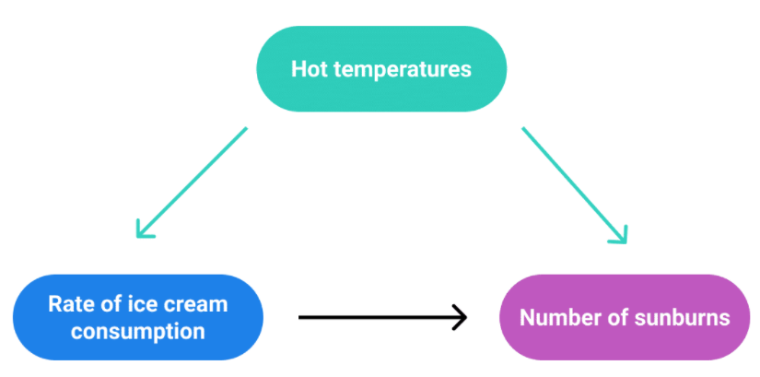
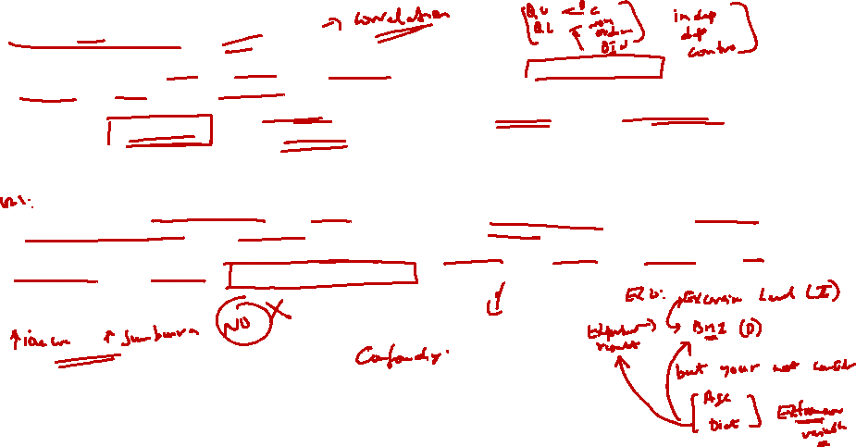
Confounding Variable
Confounding variables (a.k.a. confounders or confounding factors) are a type of extraneous variable that are related to a study’s independent and dependent variables. A variable must meet two conditions to be a confounder:
It must be correlated with the independent variable. This may be a causal relationship, but it does not have to be.
It must be causally related to the dependent variable.
A variable that hides the true effect of another variable in your experiment. This can happen when another variable is closely related to a variable you are interested in, but you haven’t controlled it in your experiment.
You collect data on sunburns and ice cream consumption. You find that higher ice cream consumption is associated with a higher probability of sunburn. Does that mean ice cream consumption causes sunburn?
Here, the confounding variable is temperature: hot temperatures cause people to both eat more ice cream and spend more time outdoors under the sun, resulting in more sunburns.

Slide 30
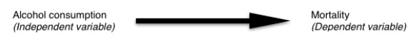
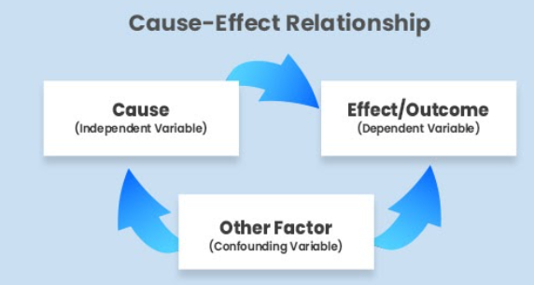
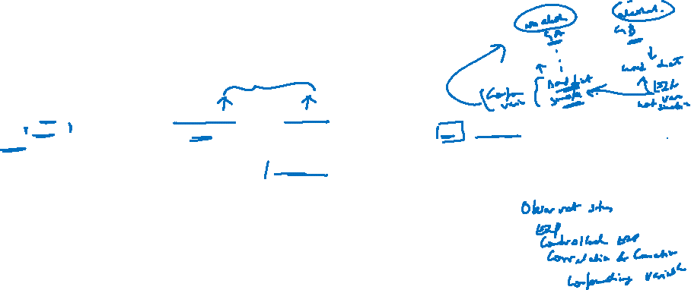
Confounding variable – another example
If you find that people who consume more alcohol are more likely to die, it might seem intuitive to conclude that alcohol use increases the risk of death. However, the situation might be more complex. It is possible that alcohol use is not the only mortality-affecting factor that differs between the two groups.
People who consume less alcohol might be more likely to eat a healthier diet or less likely to smoke, for example. Eating a healthy diet or smoking might in turn affect mortality. These other influencing factors are called confounding variables.

Slide 31
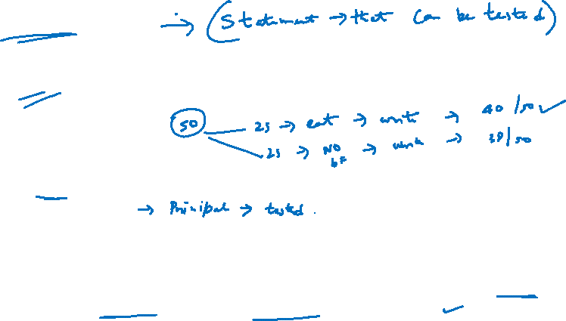
What is hypothesis ?
A hypothesis is a tentative statement about the relationship between two or more variables. It is a specific, testable prediction about what you expect to happen in a study.
A few examples:
"Students who eat breakfast will perform better on a math exam than students who do not eat breakfast."
"Students who experience test anxiety prior to an English exam will get higher scores than students who do not experience test anxiety."​
"Motorists who talk on the phone while driving will be more likely to make errors on a driving course than those who do not talk on the phone."

Slide 32

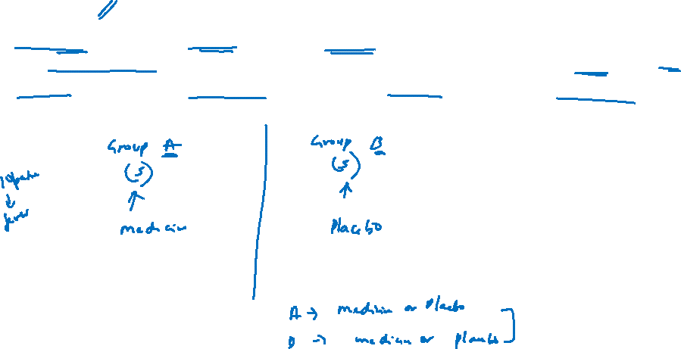
Blinding
In medical trials, the term blinding, or double-blind, usually refers to the practice of keeping patients in the dark as to whether they are receiving a placebo or not. It can also refer to allocation concealment, which is used to avoid selection bias.
EX:

Slide 33

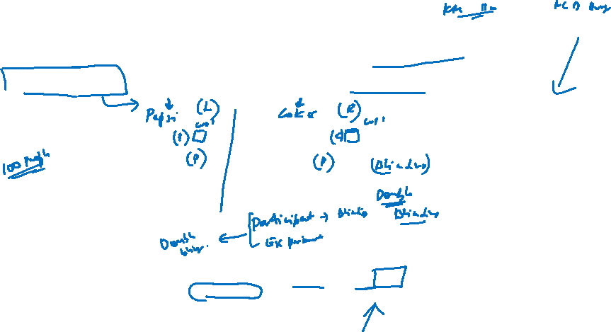
Double Blinding
A double-blind study is one in which neither the participants nor the experimenters know who is receiving a particular treatment.
EX:
Blinding and double blinding are methods that are used to try and eliminate bias that occurs when researchers and the subject are aware of which group is in which study

Slide 34
Why blinding is important in Statistics?
Blinding is especially important in subjective trials to avoid skewed results.
EX:

Slide 35


Describing Data through Statistics

Slide 36


Measure of Central Tendency

Slide 37

Finding Central Value
For Two Numbers : 3 and 7
Central value : (3 + 7) / 2 =
For three numbers : 3, 7, 8
Central value : (3+7+8) / 2 =

Slide 38
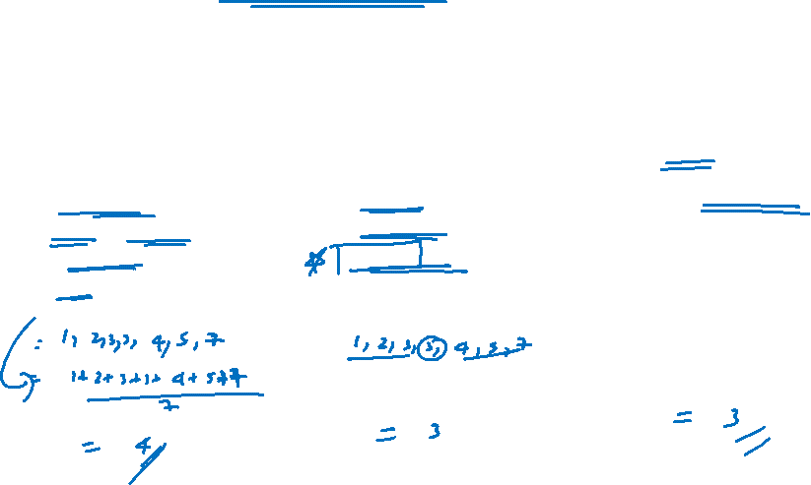
Measure of Central Tendency
Measure of central tendency yield information about the center, or middle part, of a group of numbers
MEAN :
The sum of all values divided by the total number of values
MEDIAN :
The middle number in an ordered data set
MODE :
The most frequent value

Slide 39

Ready ??????????????
Let’s Gooooooooooo…

Slide 40

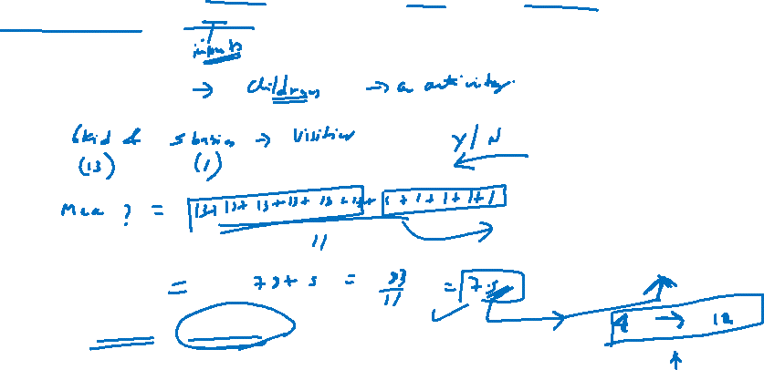
Mean
The mean is the average of a group of number and is computed by summing all numbers and dividing by the number of numbers.
Ex: of a Jumping castle
Here the mean is accurate but not useful

Slide 41

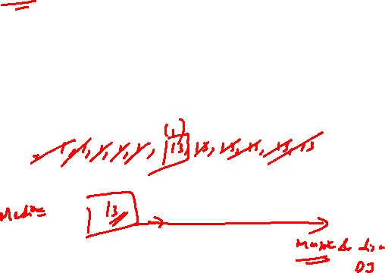
Median
List all the numbers in order and choose the middle one
Ex : Jumping castle continued
List the ages in order.

Slide 42
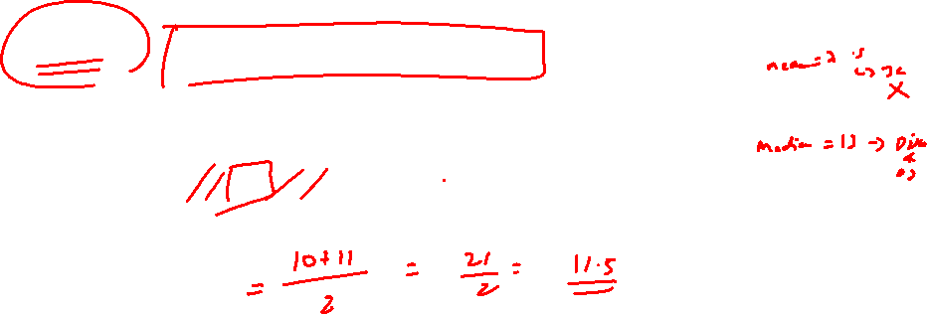
Median – Two middle numbers
If there are two middle number, then just take the average of those two numbers
Ex : find Median of 7,9,10,11,11,15

Slide 43
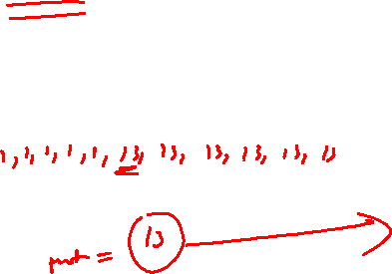
Mode
The most frequent value. (the value that occurs the highest number of times)
Ex : Jumping castle continued
Group the numbers so we can count them :

Slide 44
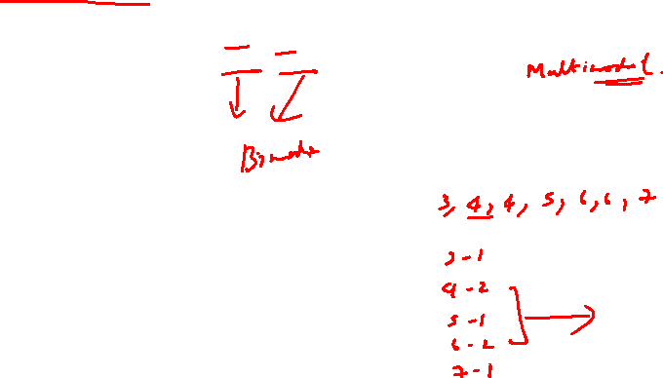
Mode
But Mode can be tricky, there can sometime be more than one mode
Ex : What is the Mode of 10,11,11,12,12,13,14

Slide 45
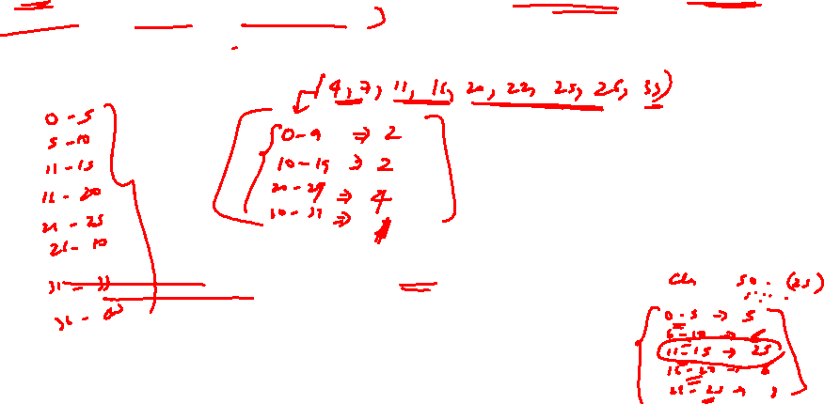
Grouping
In Some cases (such as when all values appear the same number of times) the mode is not useful. But we can group the values to see if one group has more than the others
Ex : 5, 8, 12, 17, 21, 23, 26, 27, 34
Note : You could use different grouping and get a different answer

Slide 46

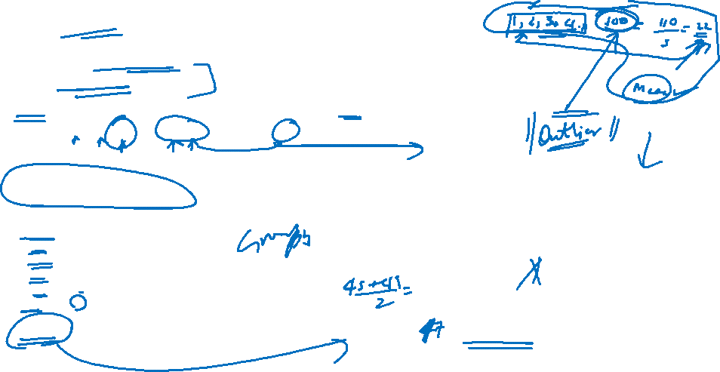
Grouping another example
Grouping also help to find what the typical values are when the real-world messes things up!
Ex : How long to load a truck?
Robert recorded how long it take to load a truck in minutes:
46, 47, 43, 53, 69, 67, 46, 50, 57, 58, 45, 48, 61
It takes longer when there is break time or lunch so an average is not very useful.
But grouping by 5s gives:
40 - 44 : 1
45 - 49 : 5
50 – 54 : 2
55 – 59 : 2
60 – 64 : 1
64 – 69 : 2
“45 – 49” appear most often, so we can say it normally take about 37 minutes to fill a pallet

Slide 47
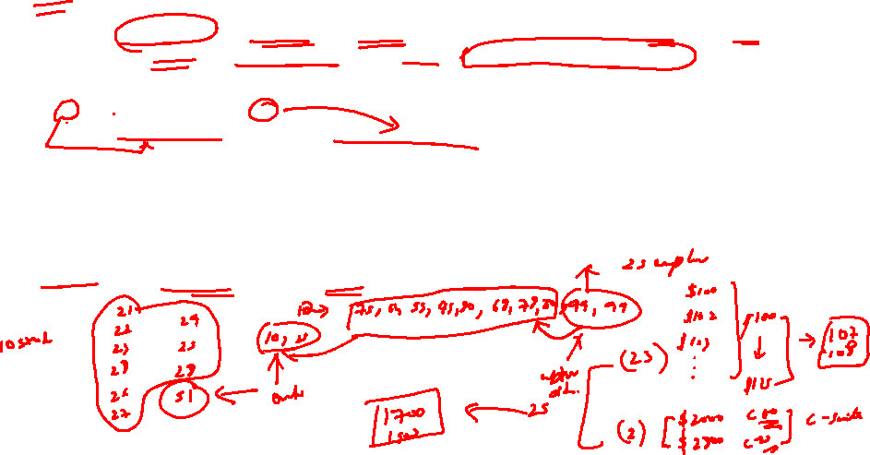
Outlier
A value that "lies outside" (is much smaller or larger than) most of the other values in a set of data. They can change the mean a lot, so we can either not used them or use mean median mode instead.
Ex : In this set of random numbers, 1 and 201 are outliers:
1, 99, 100, 101, 103, 109, 110, 201
“1” is an extremely low value and “201” is an extremely high value.
Outliers aren’t always that obvious. Let’s say you received the following paychecks last month:
$225, $250, $25, $235.
Your average paycheck is $135. But that small paycheck ($25) might be because you went on vacation, so a weekly paycheck average of $135 isn’t a true reflection of how much you earned. Your average is actually closer to $237 if you take the outlier ($25) out of the set.
Age of students studying Data science in Board Infinity
Ex :

Slide 48

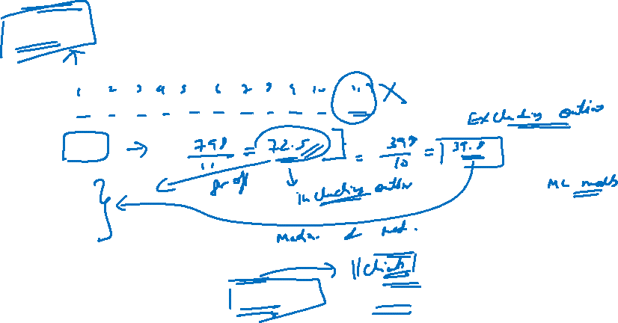
Outlier - continued
Values : 10, 20, 30, 40, 44, 44, 45, 50, 55, 60 , 400
Mean : 72.5
Median : 44
Mode : 44
Let’s learn how to identify and treat outliers in our ML classes

Slide 49
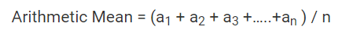

Mean – Continued Different types of Mean
Arithmetic Mean
When you add up all the values and divide by the number of values it is called Arithmetic Mean. To calculate, just add up all the given numbers then divide by how many numbers are given.
Example: What is the mean of 3, 5, 9, 5, 7, 2?
Now add up all the given numbers:
3 + 5 + 9 + 5 + 7 + 2 = 31
Now divide by how many numbers provided in the sequence:
316= 5.16
5.16 is the answer.

Slide 50
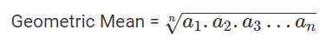

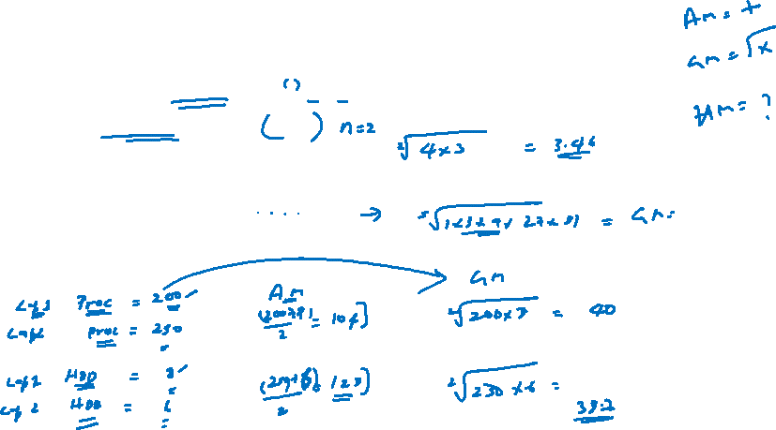
Geometric Mean
While finding geometric mean the values are multipled rather than summed up
Example: Find the geometric mean of 4 and 3 ?
Geometric Mean =√4×3=2√23= 3.46
GM of 2 numbers is like finding area and the GM of 3 numbers is like finding the volume of area..
Ex : What is geometric mean of 1,3,9,27,81 ?
Why Geometric Mean ?
Ex : Buying a laptop

Slide 51
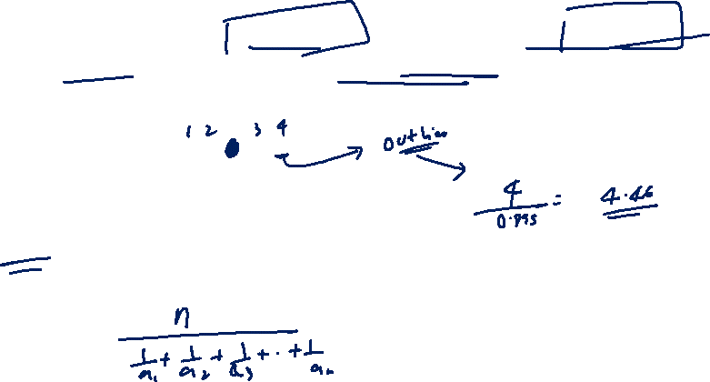
Harmonic Mean
The harmonic mean is a type of numerical average. It is calculated by dividing the number of observations by the reciprocal of each number in the series.
The reciprocal of a number n is simply 1 / n.
Ex : the harmonic mean of 2, 4, 6, 8, 50 is

Slide 52
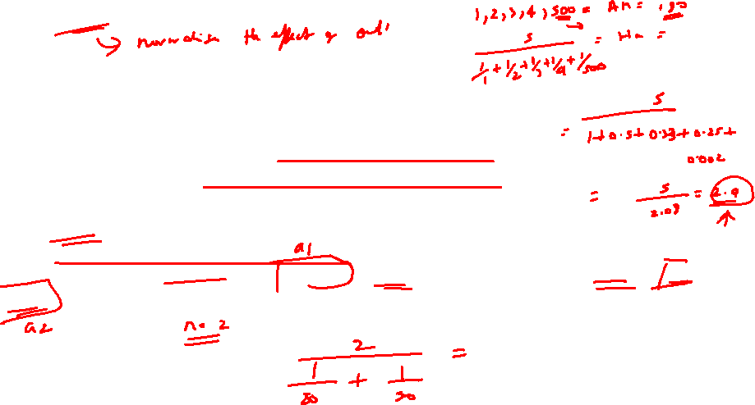
Harmonic Mean - Continued
The Harmonic mean is the reciprocal of the average of the reciprocals
The formula is :
a1, a2,a3,.. are the values and n being how many values
Why Harmonic Mean ?
Ex : Example : A car is travelling at 80 km/hr for 20km and then a another 20km at 50 km/hr, what is cars average speed?

Slide 53
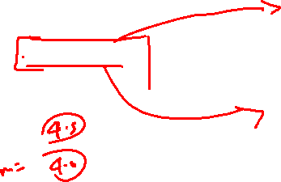
Harmonic Mean
Find harmonic mean of 4, 6, 8, 100

Slide 54

Conclusion : Mean, Median, Mode
A measure of central tendency is a measure that tells us where the middle of a bunch of data lies. The three most common measures of central tendency are the mean, the median, and the mode.
Use the one that best suits your data. Or better still use all three !

Slide 55
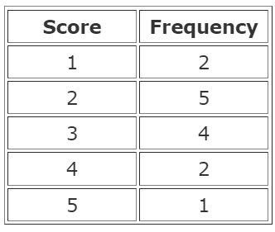
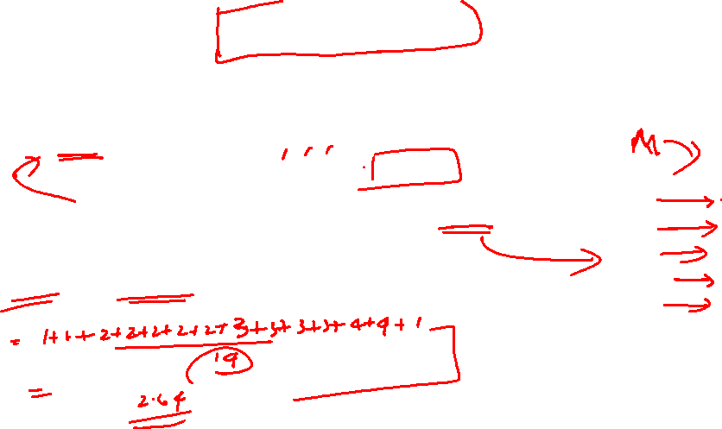
The Mean from a Frequency Table
It is easy to calculate Mean : Add up all the numbers, then divide by how many numbers there are.
Ex : What is the Mean of these numbers?
6, 11, 7
Add the numbers & Divide by 3 : (6 + 11 + 7) / 3. Mean is 8
But sometimes we don't have a simple list of numbers, it might be a frequency table like this (the "frequency" says how often they occur):
Method 1 : We can list all the numbers

Slide 56
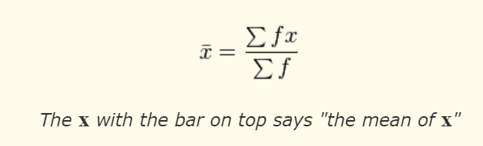
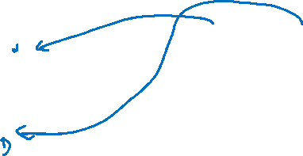
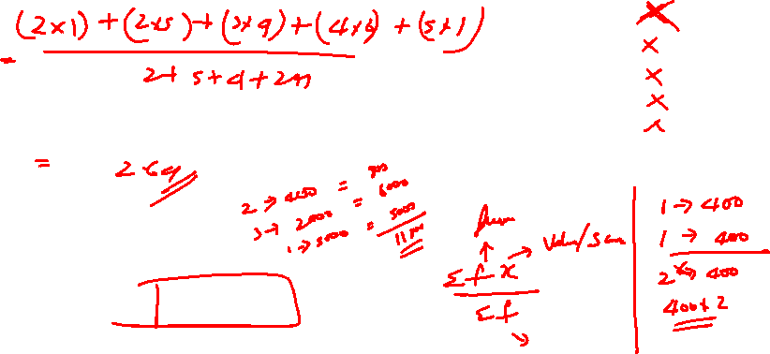
The Mean from a Frequency Table - Continued
Method 2 : It is easier to use multiplication:
Notation :

Slide 57
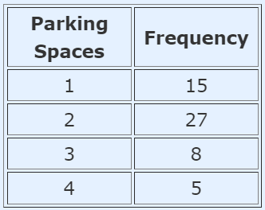
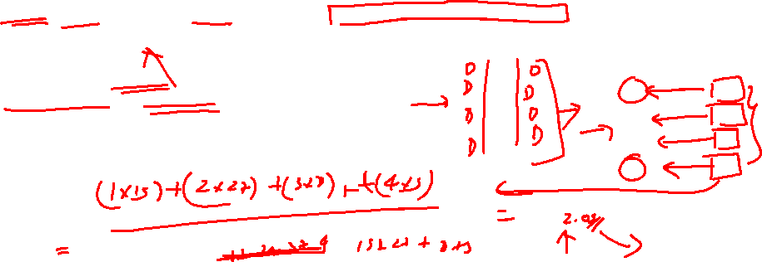
Another example of Mean from a Freq Table
Isabella went up and down the street to find out how many parking spaces each house has. Here are her results:
What is the mean number of Parking Spaces?

Slide 58
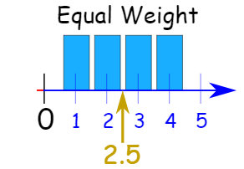
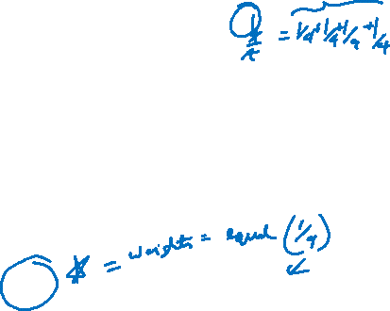
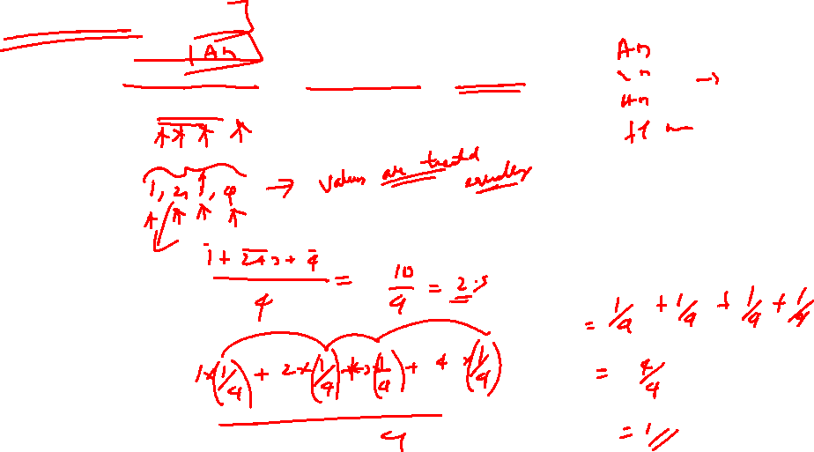
Weighted Mean
When we do a simple mean (or average), we give equal weight to each number.
What is the mean of 1, 2, 3 and 4 ?

Slide 59
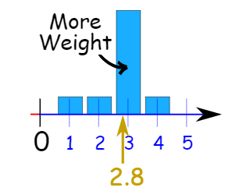

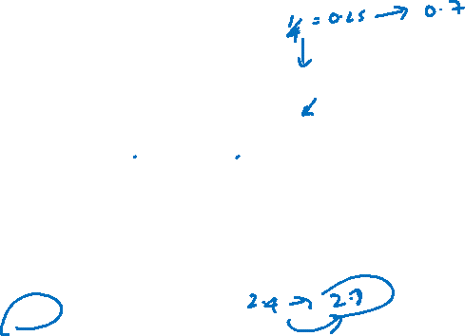
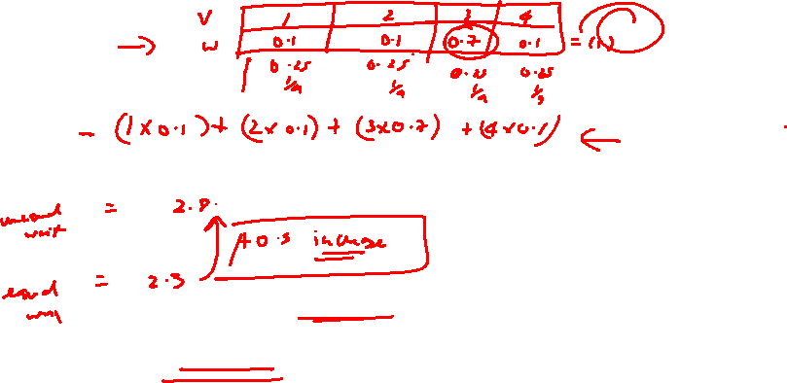
Weighted Mean
Now let's change the weight of 3 to 0.7, and the weights of the other numbers to 0.1 so the total of the weights is still 1:
When should I use Weighted mean ?

Slide 60


Weighted Mean – Example
Weighted means can help with decisions where some things are more important than others:
Question : Mike wants to buy a new camera, and decides on the following rating system:
Image Quality 50%
Battery Life 30%
Zoom Range 20%

Slide 61



What if the weights don’t add to 1 ?
When the weights don't add to 1, divide by the sum of weights.
Example: Adrian usually eats lunch 7 times a week, but some weeks only gets 1, 2, or 5 lunches.
Alex had lunch:
on 2 weeks: only one lunch for the whole week
on 14 weeks: 2 lunches each week
on 8 weeks: 5 lunches each week
on 32 weeks: 7 lunches each week
What is the mean number of lunches Alex having each week?

Slide 62



What if the weights don’t add to 1 ?
Use “Weeks” as the weighting
Solution :

Slide 63

What if the weights don’t add to 1 ?
But it is often better to use a table to make sure you have all the numbers correct:
Example (continued):
Let's use:
w for the number of weeks (the weight)
x for lunches (the value we want the mean of)
Multiply w by x, sum up w and sum up wx

Slide 64

What if the weights don’t add to 1 ?
Divide Σwx by Σw:

Slide 65


Weighted Mean : Summary
Weighted Mean: A mean where some values contribute more than others.
When the weights add to 1: just multiply each weight by the matching value and sum it all up
Otherwise, multiply each weight w by its matching value x, sum that all up, and divide by the sum of weights:

Slide 66

Measure of Variability

Slide 67

Measure of Variability
Variability describes how far apart data points lie from each other and from the center of a distribution. Along with measures of central tendency, measures of variability give you descriptive statistics that summarize your data.
Variability is also referred to as spread, scatter or dispersion. It is most commonly measured with the following:
Range: the difference between the highest and lowest values
Quartile: that divide a list of numbers into quarters
Interquartile range: the range of the middle half of a distribution
Standard deviation: average distance from the mean
Variance: average of squared distances from the mean

Slide 68


Why does variability matters?
Ex : Variability in normal distribution
Using simple random samples, you collect data from 3 groups:
Sample A: high school students,
Sample B: college students,
Sample C: adult full-time employees.
All three of your samples have the same average phone use, at 195 minutes or 3 hours and 15 minutes. This is the x-axis value where the peak of the curves are.
Although the data follows a normal distribution, each sample has different spreads. Sample A has the largest variability while Sample C has the smallest variability.

Slide 69

Range
The range tells you the spread of your data from the lowest to the highest value in the distribution. It’s the easiest measure of variability to calculate.
To find the range, simply subtract the lowest value from the highest value in the data set.
Ex: you have 8 data points from Sample A
Data (Minutes) 72 110 134 190 238 287 305 324

Slide 70

Range can be misleading
Because only 2 numbers are used, the range is influenced by outliers and doesn’t give you any information about the distribution of values.
It’s best used in combination with other measures.
So, we may be better off using Interquartile Range or Standard Deviation

Slide 71


Quartiles
Quartiles are the values that divide a list of numbers into quarters:
Put the list of numbers in order
Then cut the list into four equal parts
The Quartiles are at the "cuts"

Slide 72


Quartile
Ex : 5, 7, 4, 4, 6, 2, 8
Put them in order : 2, 4, 4, 5, 6, 7, 8
Cut the List into Quarters :

Slide 73

Quartile
Sometimes a "cut" is between two numbers ... the Quartile is the average of the two numbers
Example: 1, 3, 3, 4, 5, 6, 6, 7, 8, 8
The numbers are already in order
Cut the list into quarters:
In this case Quartile 2 is halfway between 5 and 6:
Q2 = (5+6)/2 = 5.5
And the result is:
Quartile 1 (Q1) = 3
Quartile 2 (Q2) = 5.5
Quartile 3 (Q3) = 7

Slide 74

How to find Q1, Q2, Q3 ? lets do a small example to get the understanding

Slide 75


Interquartile Range
The interquartile range gives you the spread of the middle of your distribution.
For any distribution that’s ordered from low to high, the interquartile range contains half of the values. While the first quartile (Q1) contains the first 25% of values, the fourth quartile (Q4) contains the last 25% of values.

Slide 76

Interquartile Range
Ex: you have 8 data points from Sample A
Data (Minutes) 72 110 134 190 238 287 305 324

Slide 77

Interquartile Range
Ex : To calculate it just subtract Quartile 1 from Quartile 3, like this:
The Interquartile Range is:
Q3 − Q1 = 7 − 4 = 3

Slide 78
Worksheet

Slide 79


Box and Whiskers Plot
We can show all the important values in a "Box and Whisker Plot", like this:

Slide 80


Putting it all together – Quartiles & Box and Whisker Plot
Example: Box and Whisker Plot and Interquartile Range for
4, 17, 7, 14, 18, 12, 3, 16, 10, 4, 4, 11
Put them in order: 3, 4, 4, 4, 7, 10, 11, 12, 14, 16, 17, 18
Cut it into quarters: 3, 4, 4 | 4, 7, 10 | 11, 12, 14 | 16, 17, 18
In this case all the quartiles are between numbers:
Quartile 1 (Q1) = (4+4)/2 = 4
Quartile 2 (Q2) = (10+11)/2 = 10.5
Quartile 3 (Q3) = (14+16)/2 = 15
Also:
The Lowest Value is 3,
The Highest Value is 18
And the Interquartile Range is: Q3 − Q1 = 15 − 4 = 11

Slide 81

Quartile – Five-number summary
Every distribution can be organized using a five-number summary:
Lowest value
Q1: 25th percentile
Q2: the median
Q3: 75th percentile
Highest value (Q4)
These five-number summaries can be easily visualized using box and whisker plots

Slide 82

Mean Deviation
How far, on average, all values are from the middle
Calculation Steps :
Find the mean of all values
2. Find the distance of each value from that mean (subtract the mean from each value, ignore minus signs)
3. Then find the mean of those distances

Slide 83



Mean Deviation
Example: the Mean Deviation of 3, 6, 6, 7, 8, 11, 15, 16
Step 1 : Find the mean:
Step 2 : Find the distance of each value from mean
Which looks like :

Slide 84

Mean Deviation
Step 3 : Find the mean of those distances :
Mean Deviation = 6 + 3 + 3 + 2 + 1 + 2 + 6 + 78 = 308 = 3.75
So, the mean = 9, and the mean deviation = 3.75
What does Mean Deviation say ?
It tells us how far, on average, all values are from the middle.
In that example the values are, on average, 3.75 away from the middle

Slide 85


Mean Deviation - Formula
The formula is:
Σ is Sigma, which means to sum up
|| (the vertical bars) mean Absolute Value, basically to ignore minus signs
x is each value (such as 3 or 16)
μ is the mean (in our example μ = 9)
N is the number of values (in our example N = 8)
**Note : The “Mean Deviation” is sometimes called the “Mean Absolute Deviation” (MAD) because it is the mean of the absolute deviations

Slide 86


Mean Deviation – Real life example
Ex : A group of friends have just measured the heights of their dogs ( in millimeters)
The heights at shoulders are : 600mm, 470mm, 170mm, 430mm and 300mm
Step 1 : Find mean
Step 2 : Find the absolute Deviations

Slide 87



Mean Deviation – Ex continued
Step 3 : find the Mean Deviation
So, on average, the dogs' heights are 127.2 mm from the mean

Slide 88


Mean Deviation – A useful check
The deviations on one side of the mean should equal the deviations on the other side.
From our first example:
Example: 3, 6, 6, 7, 8, 11, 15, 16
The deviations are:

Slide 89

Mean Deviation – A useful check
Example: Dogs
Deviations left of mean: 224 + 94 = 318
Deviations right of mean: 206 + 76 + 36 = 318
If they are not equal ... you may have made a mistake!

Slide 90

Standard Deviation
The Standard Deviation is a measure of how spread-out numbers are.
Its symbol is σ (the greek letter sigma)
The formula is easy: it is the square root of the Variance. So now you ask, "What is the Variance?"
Variance
The Variance is defined as: The average of the squared differences from the Mean.
To calculate the variance, follow these steps:
Work out the Mean (the simple average of the numbers)
Then for each number: subtract the Mean and square the result (the squared difference).
Then work out the average of those squared differences. (Why Square?)

Slide 91


Variance - Ex
Now we calculate each dog's difference from the Mean:
To calculate the Variance, take each difference, square it, and then average the result:

Slide 92


Variance – Ex continued
So, the Variance is 21,704

Slide 93



Standard Deviation
And the Standard Deviation is just the square root of Variance, so:
And the good thing about the Standard Deviation is that it is useful. Now we can show which heights are within one Standard Deviation (147mm) of the Mean:
So, using the Standard Deviation we have a "standard" way of knowing what is normal, and what is extra large or extra small.

Slide 94
Another Example – Standard Deviation

Slide 95
Standard Deviation – Population & Sample
Example: if our 5 dogs are just a sample of a bigger population of dogs, we divide by 4 instead of 5 like this:
Sample Variance = 108,520 / 4 = 27,130
Sample Standard Deviation = √27,130 = 165 (to the nearest mm)
Think of it as a "correction" when your data is only a sample.

Slide 96



Standard Deviation - Formula
Looks complicated, but the important change is to divide by N-1 (instead of N) when calculating a Sample Standard Deviation

Slide 97



Why Square the difference ?
If we just add up the differences from the mean ... the negatives cancel the positives:
Ex:
So that won't work. How about we use absolute values?
Ex:
That looks good (and is the Mean Deviation), but what about this case:
Ex:

Slide 98


Why Square the difference ? - Continued
So let us try squaring each difference (and taking the square root at the end):
That is nice! The Standard Deviation is bigger when the differences are more spread out ... just what we want.

Slide 99

Standard deviation - Example
Question : 95% of student at school are between 1.1m and 1.7m tall. Assuming this data is normally distributed can you calculate the mean and Standard deviation ?

Slide 100


Range of Standard Deviation/ Empirical Formula
We can expect about 68% of values to be within plus-or-minus 1 standard deviation.
Following the empirical rule:.
Around 68% of scores are between 40 and 60
Around 95% of scores are between 30 and 70
Around 99.7% of scores are between 20 and 80.

Slide 101

Coefficient of Variance (CV)
Also known as relative standard deviation (RSD), the coefficient of variation (CV) is a standardized measure of dispersion.
It tells you how variable your data is relative to the mean. It can only be used with ratio levels of measurement because it is a fraction. The coefficient of variation (CV) is the standard deviation divided by the mean.
CV = SD/Mean
CV = 36.9/13.34 = 0.36
The coefficient of variation is 0.36 or 36%. This tells you that your data has a large spread because the standard deviation is 36% of the mean

Slide 102



Example : The CV is particularly useful when you want to compare results from two different surveys or tests that have different measures or values. For example, if you are comparing the results from two tests that have different scoring mechanisms.
 | SGD | MY Ringgit
Mean
Sample Variance
Sample SD
Sample CV

Slide 103


Standard Scores – Z score
The number of Standard Deviations from the mean is also called the “standard Score”. “ Sigma” or “z-score”.
Ex : In the same school one of your friend is 1.8m tall
You can see on the bell curve that 1.85m is 3 standard deviations from the mean of 1.4, so
Your friend’s height has “z-score” of 3.0

Slide 104


Standard Scores – Z score
It is also possible to calculate how many standard deviations 1.85 is from the mean
How far is 1.85 from the mean ?
It is 1.85 – 1.4 = 0.45m from the mean
How many standard deviation is that ? The SD is 0.15m so it is
Z is “z score” (standard Score)
X is the Value to be standardized
µ is the mean
σ is the SD

Slide 105



Histograms
It is like a Bar Chart, but a histogram groups numbers into ranges .
The height of each bar shows how many fall into each range.
And you decide what ranges to use!
Ex:
The heights vary from 100 cm to 340 cm
You decide to put the results into groups of 50 cm:
The 100 to just below 150 cm range,
The 150 to just below 200 cm range,
etc...
So, a tree that is 260 cm tall is added to the "250-300" range.
And here is the result: You can see (for example) that there are 30 trees from 150 cm to just below 200 cm tall
The range of each bar is also called the Class Interval

Slide 106

Histograms
So, a tree that is 260 cm tall is added to the "250-300" range.
And here is the result: You can see (for example) that there are 30 trees from 150 cm to just below 200 cm tall

Slide 107


Difference between Bar chart and Histogram?
Histograms are a great way to show results of continuous data, such as:
weight
height
how much time
etc.
But when the data is in categories (such as Country or Favourite Movie), we should use a Bar Chart.

Slide 108


Frequency Histogram
A Frequency Histogram is a special graph that uses vertical columns to show frequencies (how many times each score occurs):
Here I have added up how often 1 occurs (2 times), how often 2 occurs (5 times), etc, and shown them as a histogram.

Slide 109




Normal Distribution
Data can be "distributed" (spread out) in different ways.
Normal Distribution :

Slide 110


Normal Distribution - Continued
It is often called a "Bell Curve“ because it looks like a bell.
Many things closely follow a Normal Distribution:
heights of people
size of things produced by machines
errors in measurements
blood pressure
marks on a test

Slide 111




Correlation
When two sets of data are strongly linked together, we say they have a High Correlation

Slide 112
Correlation Coefficient

Slide 113
Correlation - continued
Correlation Is Not Good at Curves
Ex: Ice Cream shop keeps track of how much ice cream they sell versus the temperature on that day
The correlation calculation only works properly for straight line relationships
Ex: there has been a heart wave! It gets so hot that people aren’t going to the shop, and sales start dropping

Slide 114
Correlation is NOT Causation
A common saying is "Correlation Is Not Causation".
What it really means is that a correlation does not prove one thing causes the other:
One thing might cause the other
The other might cause the first to happen
They may be linked by a different thing
Or it could be random chance!
There can be many reasons the data has a good correlation.

Slide 115
Correlation is NOT Causation
Ex : Sun glass vs Ice cream
Ex : Poor suburbs are more likely to have high pollution.

Slide 116
Correlation is NOT Causation – A real case
A few years ago, a survey of employees found a strong positive correlation between "Studying an external course" and Sick Days.

Slide 117


Skewness
Data can be "skewed", meaning it tends to have a long tail on one side or the other:
Negative Skew : Because the long "tail" is on the negative side of the peak. Some people say it is "skewed to the left" (the long tail is on the left-hand side) Mode > Median > mean
Positive Skew : And positive skew is when the long tail is on the positive side of the peak. Some people say it is "skewed to the right". Mean > Median > Mode
No Skew/ Normal distribution : A Normal Distribution is not skewed. It is perfectly symmetrical. And the Mean is exactly at the peak. Mean = Median = Mode

Slide 118


Skewness
Rule of Thumb
If the skewness is between -0.5 & 0.5, the data are nearly symmetrical.
If the skewness is between -1 & -0.5 (negative skewed) or between 0.5 & 1(positive skewed), the data are slightly skewed.
If the skewness is lower than -1 (negative skewed) or greater than 1 (positive skewed), the data are extremely skewed.

Slide 119


Kurtosis
Kurtosis is all about the tails of distribution. Kurtosis refers to the degree of presence of outliers in the distribution.
Kurtosis is a statistical measure, whether the data is heavy-tailed or light-tailed in a normal distribution

Slide 120


Kurtosis - Leptokurtic (kurtosis > 3)
Leptokurtic is having very long and skinny tails, which means there are more chances of outliers. Positive values of kurtosis indicate that distribution is peaked and possesses thick tails. An extreme positive kurtosis indicates a distribution where more of the numbers are located in the tails of the distribution instead of around the mean.

Slide 121


Kurtosis - Platykurtic (kurtosis < 3)
Platykurtic having a lower tail and stretched around center tails means most of the data points are present in high proximity with mean. A platykurtic distribution is flatter (less peaked) when compared with the normal distribution.

Slide 122


Kurtosis - Mesokurtic (kurtosis = 3)
Mesokurtic is the same as the normal distribution, which means kurtosis is near to 0. In Mesokurtic, distributions are moderate in breadth, and curves are a medium peaked height.

Slide 123

Skewness - Summary
The skewness is a measure of symmetry or asymmetry of data distribution, and kurtosis measures whether data is heavy-tailed or light-tailed in a normal distribution. Data can be positive-skewed (data-pushed towards the right side) or negative-skewed (data-pushed towards the left side).
When data skewed, the tail region may behave as an outlier for the statistical model, and outliers unsympathetically affect the model’s performance especially regression-based models. Some statistical models are hardy to outliers like Tree-based models, but it will limit the possibility to try other models. So there is a necessity to transform the skewed data to close enough to a Normal distribution.
Excess kurtosis can be positive (Leptokurtic distribution), negative (Platykurtic distribution), or near to zero (Mesokurtic distribution). Leptokurtic distribution (kurtosis more than normal distribution).Mesokurtic distribution (kurtosis same as the normal distribution).Platykurtic distribution (kurtosis less than normal distribution).

Slide 124


Central Limit Theorem
Population of Used cars in a Secondhand Showroom
Sample #1 : $2617.23
Sample #2 : $3201.34
Sample #3 : $2844.33
Taking a single value, as we did in descriptive statistics is sub optimal

Slide 125

Central Limit Theorem
We can draw many, many samples
$2521
$2551
$2568
$2594
$ 2617
$ 2620
$ 2623
$ 2661
$ 2685
$ 2687
$ 2711
$ 2744
$ 2748
$ 2786
$ 2804
$ 2804
$ 2843
$ 2844
$ 2844
$ 2691
$ 3030
$ 3201
$ 3240
Sampling Distribution
~$ 2800
µ
Sampling Distribution of the MEAN

Slide 126


Central Limit Theorem
Distribution of Car Prices
Right Skewed

Slide 127


Central Limit Theorem
Sampling Distribution of the MEAN
Normal Distribution

Slide 128

Central Limit Theorem
Original distribution
Sampling distribution
No matter the underlying distribution, the sampling distribution approximates a normal distribution, and the mean of the sampling distribution will be same as the population mean
Usually for CLT to be applied with need sample size of at least 30 observations

Slide 129

Why CLT is important ?
They approx. a wide variety of random variable
Distributions of sample with large enough sample sizes could be approximated to normal
All Computable statistics are elegant
Decision based on normal distribution insights have a good track record
CLT allows us to perform test, solve problems and make inferences using the normal distribution, even when the population is not normally distributed

Slide 130


Probability
How likely something is to happen.
Many events can't be predicted with total certainty. The best we can say is how likely they are to happen, using the idea of probability.
Tossing a Coin
Head or Tail ?

Slide 131



Probability
Throwing Dice
Probability Formula

Slide 132



Probability Example
Ex 1 : the chances of rolling a "4" with a die
Ex 2 : there are 5 marbles in a bag: 4 are blue, and 1 is red. What is the probability that a blue marble gets picked?

Slide 133


Probability Line
Probability is the chance that something will happen. It can be shown on a probability line
Probability does not tell us exactly what will happen, it is just a guide
Range of Probability : Between 0 and 1

Slide 134

Probability - Words
Experiment : a repeatable procedure with a set of possible results.
Ex : Throwing a dice

Slide 135

Probability - Words
Outcome : A possible result of an experiment.
Ex : Getting a 6

Slide 136


Probability - Words
Sample Space: all the possible outcomes of an experiment.
Ex : choosing a card from a deck

Slide 137


Probability - Words
Sample Point: just one of the possible outcomes
Ex : Deck of Cards
the 5 of Clubs is a sample point
the King of Hearts is a sample point
"King" is not a sample point. There are 4 Kings, so that is 4 different sample points.3
Ex : Throwing a dice
There are 6 different sample points in the sample space.

Slide 138

Probability - Words
Event: one or more outcomes of an experiment
Example Events:
An event can be just one outcome:

Slide 139



Probability – Let’s use the words
Example: Alex wants to see how many times a "double" comes up when throwing 2 dice.
The Sample Space is all possible Outcomes (36 Sample Points):
{1,1} {1,2} {1,3} {1,4} ... {6,3} {6,4} {6,5} {6,6}
The Event Alex is looking for is a "double", where both dice have the same number. It is made up of these 6 Sample Points:
{1,1} {2,2} {3,3} {4,4} {5,5} and {6,6}
These are the results:

Slide 140

Basic Counting Principle
When there are m ways to do one thing, and n ways to do another, then there are m×n ways of doing both.
Example: you have 3 shirts and 4 pants.
That means 3×4=12 different outfits.
Example: There are 6 flavors of ice-cream, and 3 different cones.
That means 6×3=18 different single-scoop ice-creams you could order.

Slide 141




Basic Counting Principle
It also works when you have more than 2 choices:
Example: You are buying a new car.
There are 2 body styles
There are 5 colors available
There are 3 models :
GL (standard model),
SS (sports model with bigger engine)
SL (luxury model with leather seats)
How many total choices you have ?

Slide 142


Basic Counting Principle – Ex continued
You can count the choices, or just do the simple calculation:

Slide 143

Independent or Dependent
But it only works when all choices are independent of each other.
If one choice affects another choice (i.e. depends on another choice), then a simple multiplication is not right.
Ex : you are buying a car, but the salesman says you can’t choose black for the hatchback.. Well then things change

Slide 144


Independent or Dependent – Ex continued
Because your choices are not independent of each other.
But you can still make your life easier with this calculation:

Slide 145

Mutually Exclusive Events
Mutually Exclusive: can't happen at the same time.
Ex :

Slide 146


Mutually Exclusive Events
What is not Mutually exclusive ?
Turning left and scratching your head can happen at the same time
Kings and Hearts, because we can have a King of Hearts!

Slide 147

Mutually Exclusive Events
When two events (call them "A" and "B") are Mutually Exclusive it is impossible for them to happen together:
P(A and B) = 0
"The probability of A and B together equals 0 (impossible)"
Example: King AND Queen
A card cannot be a King AND a Queen at the same time!
The probability of a King and a Queen is 0 (Impossible)

Slide 148

Mutually Exclusive Events
Example: King OR Queen
Find what's the probability of getting a king or Queen ?

Slide 149



Mutually exclusive events
When events are not Mutually exclusive – be careful in calculation !!
What is the probability of getting a KING or Heart ?
But Hearts or Kings is:
all the Hearts (13 of them)
all the Kings (4 of them)
But that counts the King of Hearts twice!
So, the correct answer is ?

Slide 150


When events are not Mutually exclusive – be careful in calculation !!
P(A or B) = P(A) + P(B) − P(A and B)
"The probability of A or B equals the probability of A plus the probability of B minus the probability of A and B“
Ex : 16 people study French, 21 study Spanish and there are 30 altogether. Work out the probabilities!
This is definitely a case of not Mutually Exclusive (you can study French AND Spanish).
Let's say b is how many study both languages:
people studying French Only must be 16-b
people studying Spanish Only must be 21-b
And we get :

Slide 151



When events are not Mutually exclusive – be careful in calculation !!

Slide 152

Conditional Probability
Conditional probability is defined as the likelihood of an event or outcome occurring, based on the occurrence of a previous event or outcome.
Conditional probability is calculated by multiplying the probability of the preceding event by the updated probability of the succeeding, or conditional, event.
For example 1:
Event A is that an individual applying for college will be accepted. There is an 80% chance that this individual will be accepted to college.
Event B is that this individual will be given dormitory housing. Dormitory housing will only be provided for 60% of all of the accepted students.
P (Accepted and dormitory housing) = P (Dormitory Housing | Accepted) P (Accepted) = (0.60)*(0.80) = 0.48.

Slide 153

Conditional Probability – Example 2
Example: Drawing 2 Kings from a Deck
Event A is drawing a King first, and Event B is drawing a King second.
For the first card the chance of drawing a King is 4 out of 52 (there are 4 Kings in a deck of 52 cards):
P(A)
P(B|A)
So P(A and B) = P(A) x P(B|A) =
So the chance of getting 2 kings is 1 in 221 or about 0.5%

Slide 154


Conditional Probability
Using Algebra, we can also "change the subject" of the formula, like this:
Start with: P(A and B) = P(A) x P(B|A)
Swap sides: P(A) x P(B|A) = P(A and B)
Divide by P(A): P(B|A) = P(A and B) / P(A)
And we have another useful formula:

Slide 155

Conditional Probability
Example: Ice Cream
70% of your friends like Chocolate, and 35% like Chocolate AND like Strawberry.
What percent of those who like Chocolate also like Strawberry?
P(Strawberry|Chocolate) = P(Chocolate and Strawberry) / P(Chocolate)

Slide 156



Confusion Matrix
A confusion matrix is a table that is often used to describe the performance of a classification model (or "classifier") on a set of test data for which the true values are known.
Let's now define the most basic terms, which are whole numbers (not rates):
true positives (TP): These are cases in which we predicted yes (they have the disease), and they do have the disease.
true negatives (TN): We predicted no, and they don't have the disease.
false positives (FP): We predicted yes, but they don't actually have the disease. (Also known as a "Type I error.")
false negatives (FN): We predicted no, but they actually do have the disease. (Also known as a "Type II error.")

Slide 157

Confusion Matrix
Some examples of “False Positives”
A pregnancy test is positive, when in fact you aren’t pregnant.
A cancer screening test comes back positive, but you don’t have the disease.
A prenatal test comes back positive for Down’s Syndrome, when your fetus does not have the disorder.
Virus software on your computer incorrectly identifies a harmless program as a malicious one.

Slide 158

Confusion Matrix
Some examples of “False Negatives”
In software testing, a false negative would mean that a test designed to catch something (i.e. a virus) has failed.
In the Justice System, a false negative occurs when a guilty suspect is found “Not Guilty” and allowed to walk free.

Slide 159



Example : Allergy or Not ?
Hunter says she is itchy. There is a test for Allergy to Cats, but this test is not always right:
For people that really do have the allergy, the test says "Yes" 80% of the time
For people that do not have the allergy, the test says "Yes" 10% of the time ("false positive")
Here is the table :

Slide 160

Question :
If 1% of the population have the allergy, and Hunter's test says "Yes", what are the chances that Hunter really has the allergy?
There are three different ways to solve this:
"Imagine a 1000",
"Tree Diagrams"
"Bayes' Theorem",

Slide 161


Solution 1 : Imagine a thousand people
So, 107 people get a "Yes" but only 8 of those really have the allergy:
8 / 107 = about 7%
So, even though Hunter's test said "Yes", it is still only 7% likely that Hunter has a Cat Allergy.
Why so small? Well, the allergy is so rare that those who actually have it are greatly outnumbered by those with a false positive.

Slide 162


Solution 2 : Tree Diagram
First, let's check that all the percentages add up:
0.8% + 0.2% + 9.9% + 89.1% = 100% (good!)
And the two "Yes" answers add up to 0.8% + 9.9% = 10.7%, but only 0.8% are correct.
0.8/10.7 = 7% (same answer as above)

Slide 163


Bayes theorem
In Probability theory and statistics, Bayes theorem (alternatively Bayes law or Bayes rule) describe the probability of an event, based on conditions that might be related to the event
The bayes theorem was developed and name for Thomas Bayes (1702 – 1761)

Slide 164

Bayes Theorem – When to apply ?
Part of the challenge in applying Bayes theorem involves recognizing the types of problems that warrant its use. You should consider Bayes theorem when the following conditions exit.
Within the sample space, there exists an event B, for which P(B) > 0
The analytical goal is to compute a conditional probability of the form : P (A | B)
You know at least one of the two set of probabilities described below :
P ( A n B) for each A
P (A) and P (B | A) for each A

Slide 165

Bayes theorem - continued
Where A and B are events:
P(A) and P(B) are the probabilities of A and B without regard to each other
P (A | B) : a conditional probability is the probability of observing event A given the B is true.
P(B | A) is the probability of observing event B given that A is true.

Slide 166


Bayes theorem – Example 1

Slide 167


Bayes theorem – Example 1

Slide 168


Bayes theorem – Example 1

Slide 169


Bayes theorem – Example 1
We want to know P (A1 | B). The probability it will rain on the day of Marie’s wedding, given the forecast for rain by the weatherman. The answer can be determined from Bayes Theorem

Slide 170

Bayes theorem – Example 2
Suppose someone told you they had a nice conversation with someone on the train. Not knowing anything else about this conversation, the probability that they were speaking to a woman is 50%. Now suppose they also told you that this person had long hair. It is now more likely they were speaking to a woman, since women in in this city are more likely to have long hair than men. Bayes theorem can be used to calculate the probability that the person is a woman.

Slide 171


Solution 3: Hunter’s test > Bayes Theorem
Bayes' Theorem has a special formula for this kind of thing:

Slide 172



Solution 3 : Bayes Theorem
To be clearer, let's change A to has (actually has allergy) and B to Yes (test says yes):
Which is about 7%

Slide 173


Random Variable
A Random Variable is a set of possible values from a random experiment.
Example: Tossing a coin: we could get Heads or Tails.
Let's give them the values Heads=0 and Tails=1 and we have a Random Variable "X":
In short:
X = {0, 1}

Slide 174

Random Variable
Not Like an Algebra Variable
In Algebra a variable, like x, is an unknown value
Example: x + 2 = 6
In this case we can find that x=4
But a Random Variable is different ...
A Random Variable has a whole set of values and it could take on any of those values, randomly.
Example: X = {0, 1, 2, 3}
X could be 0, 1, 2, or 3 randomly.
And they might each have a different probability.

Slide 175


Sample Space
A Random Variable's set of values is the Sample Space.
Ex : Throw a dice once
Random Variable X =

Slide 176


Probability
We can show the probability of any one value using this style:
P(X = value) = probability of that value
Example (continued): Throw a die once
X = {1, 2, 3, 4, 5, 6}
In this case they are all equally likely, so the probability of any one is 1/6
P(X = 1) = 1/6
P(X = 2) = 1/6
P(X = 3) = 1/6
P(X = 4) = 1/6
P(X = 5) = 1/6
P(X = 6) = 1/6
Note that the sum of the probabilities = 1, as it should be.

Slide 177


Probability - Continued
Example: How many heads when we toss 3 coins?
X = "The number of Heads" is the Random Variable.
In this case, there could be 0 Heads (if all the coins land Tails up), 1 Head, 2 Heads or 3 Heads.
So, the Sample Space = {0, 1, 2, 3}
But this time the outcomes are NOT all equally likely.
The three coins can land in eight possible ways:
X = "Number of Heads"
Looking at the table we see just 1 case of Three Heads, but 3 cases of Two Heads, 3 cases of One Head, and 1 case of Zero Heads. So:.
P(X = 3) = 1/8
P(X = 2) = 3/8
P(X = 1) = 3/8
P(X = 0) = 1/8

Slide 178

Random Variable – Discrete data
Type of Random Variables
Discrete Data can only take certain values (such as 1,2,3,4,5)
Discrete data is counted
Example 1:
Example 2 :

Slide 179
Random Variable – Continuous data
Continuous Data can take any value within a range (such as a person's height)
Examples :

Slide 180

Confidence Intervals
A Confidence Interval is a range of values we are fairly sure our true value lies in.
Example: Average Height
We measure the heights of 40 randomly chosen men, and get a mean height of 175cm,
We also know the standard deviation of men's heights is 20cm.
The 95% Confidence Interval (we show how to calculate it later) is:

Slide 181

Calculating the Confidence Interval
Step 1: start with
the number of observations n
the mean X
and the standard deviation s
Note: we should use the standard deviation of the entire population, but in many cases we won't know it.
We can use the standard deviation for the sample if we have enough observations (at least n=30, hopefully more).
Using our example:
number of observations n =
mean X =
standard deviation s =

Slide 182


Calculating the Confidence Interval
Step 2: decide what Confidence Interval we want: 95% or 99% are common choices. Then find the "Z" value for that Confidence Interval here:
For 95% the Z value is ?

Slide 183


Calculating the Confidence Interval
Step 3: use that Z value in this formula for the Confidence Interval
Where:
X is the mean
Z is the chosen Z-value from the table above
s is the standard deviation
n is the number of observations

Slide 184

Calculating the Confidence Interval
And we have:
Which is :
In other words : from 168.8cm to 181.2cm

Slide 185


Calculating the Confidence Interval
The 95% confidence interval is :
This says the true mean of all men (if we could measure all their heights_ is likely to be between 168.8cm and 181.2cm
But is might not be !!

Slide 186



Example 2 : Apple Orchid
Are the apples big enough?
There are hundreds of apples on the trees, so you randomly choose just 46 apples and get:
a Mean of 86
a Standard Deviation of 6.2
So, let's calculate:

Slide 187

Example 2 : Apple Orchid
We know:
X is the mean = 86
Z is the Z-value = 1.960 (from the table above for 95%)
s is the standard deviation = 6.2
n is the number of observations = 46
So, the true mean (of all the hundreds of apples) is likely to be between 84.21 and 87.79

Slide 188


Example 2 : Apple Orchid – True Mean
Now imagine we get to pick ALL the apples straight away, and get them ALL measured by the packing machine (this is a luxury not normally found in statistics!)
And the true mean turns out to be 84.9
Let's lay all the apples on the ground from smallest to largest:

Slide 189

Example 2 : Apple Orchid – True Mean
Our result was not exact ... it is random after all ... but the true mean is inside our confidence interval of 86 ± 1.79 (in other words 84.21 to 87.79)
Now the true mean might not be inside the confidence interval, but in 95% of the cases it will be!
95% of all "95% Confidence Intervals" will include the true mean.

Slide 190
Example 2 : Apple Orchid – True Mean
That does not include the true mean. That can happen about 5% of the time for a 95% confidence interval.
So how do we know if our sample is one of the "lucky" 95% or the unlucky 5%? Unless we get to measure the whole population like above, we simply don't know.
This is the risk in sampling, we might have a "bad" sample

Slide 191

Sampling Techniques

Slide 192

Importance of p-Value
Let’s perform an experiment :
Flip a coin > Assume we get “head
P(H) = 0.5
Flip the coin again > assume get “head” again
P(H | H) = 0.5 X 0.5 = 0.25
Now before proceeding : “ Is this a fair coin ?”
What’s your answer ? Yes or No
How do you support your answer ?
Here Null hypothesis = Ho = Is a fair coin !!
Let’s keep on tossing our coin to figure out whether we should
Reject Ho
Accept Ho

Slide 193

Importance of p-Value
3. Flip a coin > Assume we get “head” again
P(H | 2H) = 0.5 X 0.5 X 0.5 = 0.125
4. Flip a coin > Assume we get “head” again
P(H | 3H) = 0.5 X 0.5 X 0.5 X 0.5 = 0.0625
5. Flip a coin > Assume we get “head” again
P(H | 4H) = 0.5 X 0.5 X 0.5 X 0.5 X 0.5 = 0.0312
2 concepts
Confident level = 97%
p-value or significance level = 3%
We can say that chance of we getting a 5H in a row is just 3% and not getting 5H in a row is 97%

Slide 194
Importance of p-Value
We can say that chance of we getting a 5H in a row is just 3% and not getting 5H in a row is 97%
Hence, we reject out Null Hypothesis Ho i.e the coin is fair
Note : when we reject Ho we accept H1 i.e the Alternate Hypothesis – The coin is not fair !!
Remember : The p- value is a calculation that we make during hypothesis testing to determine if we reject the null hypothesis or fail to reject it

Slide 195

Linear Algebra

Slide 196

Matrix
What is a Matrix ?
Matrix is a very useful topic that comes under linear algebra. It is an arrangement of elements, especially numbers, in a particular way. A matrix is a mathematical structure having rows and columns.
We use row to represent samples
Columns represent the value of the variable (or attributes)
It is also possible to use rows for variables and columns for sample

Slide 197


Data representation : examples
A real life example
Consider a reactor which need to be controlled using multiple attributes from various sensors like Pressure (Pa). Temp (K) , Density (gm/m^3) etc.
Independently, the sensors have generated 1000 data points

Slide 198


Matrix multiplication
First, each entry in the row of the first matrix is multiplied by the corresponding entry in the column if the second matrix and summed up.
This will produce the first entry in the final matrix
The same row is then multiplied for the rest of the columns in the second matrix
The process is the same for second row and then repeated across the entire matrix

Slide 199




Multiply a Matrix by Another Matrix

Slide 200

Matrix Multiplication

Slide 201


Matrix multiplication – Now in reverse
The same 3X2 matrix and a 2X3 matrix multiplies in reverse will produce 3X3 matrix
Note that the number of rows in the first matrix and number of columns in the second matrix (show in bold above) will determine the size of final matrix

Slide 202

Matrix multiply by a scalar number

Slide 203


Matrix multiplication - Compatibility
A matrix is compatible with another only if the number of columns in the first matrix is equal to the number of rows in the second

Slide 204

Order of Multiplication

Slide 205



Identity Matrix
It is “square” (has same number of rows as columns)
It can be large or small (2x2, 100x100,… so on)
It has 1s on the main diagonal and 0s everywhere else
Its symbol is the capital letter I
It is a special matrix, because when we multiply by it, the original matrix is unchanged

Slide 206

Factorization
Factors of a number are numbers that divide evenly into another number. Factorization writes a number as the product of smaller numbers

Slide 207

Why do we use factorization ?
It can be used for many things, like helping perform arithmetic operation.
For ex 15 X 8
Factor 15 and 8 :
15 = 3X5
8 = 2X4
Now we group the factors so that it is easier for us to multiply
(2X5) X (3X4) = 10 X 12 = 120

Slide 208


Prime Factorization
Let's complete the prime factorization of the number 24
The prime factors of the number 24 are found to the right of the vertical line
24 = 2 X 2 X 2 X 3

Slide 209

Hypothesis Testing

Slide 210


Hypothesis testing
A hypothesis is a tentative statement about the relationship between two or more variables. It is a specific, testable prediction about what you expect to happen in a study.
A few examples:
"Students who eat breakfast will perform better on a math exam than students who do not eat breakfast.“
"Students who experience test anxiety prior to an English exam will get higher scores than students who do not experience test anxiety."​
"Motorists who talk on the phone while driving will be more likely to make errors on a driving course than those who do not talk on the phone."
Notes:
A hypothesis is an idea that can be tested

Slide 211


Hypothesis Testing
There are two hypotheses that are made the null hypothesis denoted Ho and the alternative hypothesis denoted H1 or Ha.
The null hypothesis is the one to be tested and the alternative is everything else.
In our example, the null hypothesis would be.

Slide 212


Hypothesis Testing
Ho is like “innocent until proven guilty”

Slide 213

Characteristics of Hypothesis
The hypothesis should be clear and precise to consider it to be reliable.
If the hypothesis is a relational hypothesis, then it should be stating the relationship between variables.
The hypothesis must be specific and should have scope for conducting more tests.
The way of explanation of the hypothesis must be very simple and it should also be understood that the simplicity of the hypothesis is not related to its significance.

Slide 214

Null hypothesis
It is an assertion that we hold as true unless we have a sufficient statistical evidence to conclude otherwise
Null hypotheses is denoted by Ho
If a population mean is equal to hypothesized mean, then null hypothesis can be written as
Ho : µ = µo

Slide 215



Alternate Hypothesis
The Alternate hypothesis is negation of null hypothesis and is denoted by Ha or H1
If Null is given as
Then alternate hypothesis can be written as

Slide 216

Level of Significance and Confidence Interval
Significance mean the percentage of risk to reject a null hypothesis when it is true, and it is denoted by α. Generally taken as 1%, 5%, 10% . Its value is often 5%
(1- α) is the confidence interval in which the null hypothesis will exist when it is true,

Slide 217


Risk of rejecting a Null Hypothesis

Slide 218


Two Tailed test @ 5% Significance Level

Slide 219


Left Tailed test @ 5% Significance Level

Slide 220


Right Tailed Test @ 5% Significance Level

Slide 221


Hypothesis Testing Examples
The average IQ for the adult population is 100 with a standard deviation of 15. A researcher believed this value as changes. The researcher decided to test the IQ of 75 random adults. The average IQ of the sample is 104. Is there enough evidence to suggest the average IQ has changed ?

Slide 222

Hypothesis Testing - Steps
State null (Ho) and alternative (H1 or Ha) hypothesis
Choose level of significance (α )
Find Critical values
Find test statistics
Draw you conclusion

Slide 223

Hypothesis testing : Example 1
Step 1: State Null & Alternative Hypothesis
Ho : μ = 100
H1 : μ != 100
Average IQ of the adult population is 100
A researcher believes this value has changed
Simple Rules:
Null hypothesis should always have = or >= or <= symbol
Alternative hypothesis could have one of these > or < or !=
Alternative hypothesis is “what is being claimed”
When H1 has != then we do a two tailed test
When H1 has either > or < or >= or <= then we do a one tailed test
**Note : Hypothesis Testing is done to prove whether Ho can be Rejected or Accepted

Slide 224


Hypothesis testing : Example 1
Step 2: Choose the level of Significance
This is the area under the curve (marked red)
Usually, values are 5% or 1 %
5% => .05
1% = > 0.01
Note : If our test statistics comes in red tail’s part then we would Reject Ho else we will Reject Ho

Slide 225


Hypothesis testing : Example 1
Step 3 : Find Critical Values
How do we decide between z-value or t-value ?
If the Std Deviation of population is not given .
If the Sample size <30
Then find t- value, b using a t-table
Here we need to find Z-value or T-value

Slide 226


Hypothesis testing : Example 1
σ = 15 (standard deviation of 15)
Sample Size > 30 ( researchers decides to test the IQ of 75 random adults)

Slide 227


Hypothesis testing : Example 1
Step 4 : find test statistics i.e the Z-value in this case
(Test Statistics)
So, our test statistics value is 2.89

Slide 228

Hypothesis testing : Example 1
Reject Ho ?
Accept Ho ?
So, our test statistics value is 2.89
Hence, we can say with 95% confidence that there is enough evident to support the claim : “Avg IQ has changed”

Slide 229

Hypothesis testing : Example 2
The average IQ of the adult population is 100. A researcher believed the average IQ of adults is lower.
A random sample of 5 adults are tested and scored
69, 79, 89, 99, 109 ( SD = 15.81)
Is there enough evidence to suggest the average IQ is lower ?

Slide 230


Hypothesis testing : Example 2
Recall : 5 steps for Hypothesis testing
Understand the data given
Ho : μ = 100
H1 : μ < 100
Step 3 : Find Critical Values
Here we need to find z- Value or T- value ?
When to use T – Values
σ is unknown
Sample size is less than 30

Slide 231


Hypothesis testing : Example 2
Df = Degrees pf Freedom
= (sampleSize – 1)

Slide 232



Hypothesis testing : Example 2
The C.V : Critical value on the left is –ve and the C.V on the right is +ve
Step 4 : Find Test Statistics. i.e The t-Value in this case
Test Statistic

Slide 233


Hypothesis testing : Example 2
Step 5 : conclusion
Accept Ho : µ = 100
Hence, we say with 95% confidence that there is enough evidence to support the claim : “ Avg IQ = 100” or we lack evidence to support “ Lower IQ’s”
Center point of the Normal Distribution is always t = 0 or Z = 0

Slide 234

Important Takeaways
How to make hypothesis {Null & Alternative } from a problem statement?
[Understand here what statistics can and cannot do !!]
Statistics cannot prove something true or right
It can only prove an assumption or hypothesis as false
Ex: in court you are either Not guilty or guilty; its never innocent
Claims or Hypothesis can be of 2 types
Based on proportion
Based on mean
Ex Most people get jobs thru Networking
The average payload of truck on NH is 1.2 tons

Slide 235

Important Takeaways
4. Ho, null hypothesis should always have =, >= , <= or !=
5. Understand how to define hypothesis or claim thru below examples
Remember to start by assuming that your Ho is True
Ex 1: The mean of the fluid is at least 100ml in a can
Write the claim
Write the opposite
Claim : μ >= 100
Opposite : µ <100
As = here, hence it is Ho

Slide 236

Important Takeaways
Ex 2 : Most CEOs are male
Claim : p > 0.5 (proportion)
Opp : p <= 0.5
As = here, hence it is Ho
Ho : p <= 0.5
H1: p > 0.5
Thereby, we would perform hypothesis testing to Reject or not reject Ho

Slide 237

Chi – Square Test (also called Goodness of fit test)
Purpose :
Groups and Numbers
You research two groups and put them in categories single, married or divorces:
The numbers are different in each group, but
Is that just random chance ?
Or have you found something interesting ?
The Chi-Square test gives a “p” value to help you decide !
Chi Square statistics are formulated to determine whether an observed number differs either from change or from what was expected
Pearson had termed it as a Goodness-of-fit test to describe how well theoretically the observed frequencies fit the expected frequencies

Slide 238



Chi – Square Test - Example
A casino, state that following is the way die throws show up = >
Could you find out, whether the Casino is using a Fair Dice or not ?
We would follow same 5 steps of Hypothesis testing.
Total throws = 204
E(1) = (1/6) * 204 = 34
E(2) = (1/6) * 204 = 34
…..
…..
Step 1 : Define Ho
Ho : Die is fair
H1 : Die is unfair
Means : observed data fits the expected data

Slide 239


Chi – Square Test - Example
Step 2 : Choose the significance level.
5% or 1 % = 0.05 or 0.01

Slide 240




Chi – Square Test - Example
Steps 3 : Compute the critical value. Use the Chi – Squared table. { Not Z / T table }
df = degree of freedom = (possible outcomes – 1)
df = 6 -1 = 5

Slide 241





Chi – Square Test - Example
Step 4 : compute the Chi – Squared test statistics
O = Observed (actual) value
E = Expected value
We get the answer >
Test statistic

Slide 242

Chi – Square Test - Example
Step 5 : Conclusion
Ho : Die is fair (Reject)
H1 : Die is unfair (Accept)
As 15.29 > 15.086, the test statistic falls in the rejection region.
So, we can reject Ho

Slide 243


Chi – Squared Test – Another Example

Slide 244

ANOVA Analysis of Variance

Slide 245

ANOVA test – Analysis of variance test
How do we compare means of many population groups?
Concept : This is a kind of Hypothesis Testing.
We can compare population means of 2 or more groups
Assume Ho : μ1 = μ2 = μ3 = ……= μk “k” is population
Ha : At least one mean differs from the other
There are other techniques like
Independent Sample : t - test
Dependent Samples : t – test
Note : Both can compare just two population parameters. Hence ANOVA is more common
Objective of ANOVA is to
Reject Ho
Fail to Reject Ho

Slide 246

Types of ANOVA
ANOVA
One Way ANOVA
Two way ANOVA
One Independent variable
Only one ‘p’ value is obtained
Two Independent variable
Three different ‘p’ value is obtained

Slide 247


ANOVA - EX
We want to measure “Level of Stress” during layoffs.
We have some observations as above

Slide 248



ANOVA - Steps
1) Find the variance within groups i.e sum of squared within groups (called SSW)
2) Find the variance between groups i.e sum of squared between groups (called SSB)

Slide 249



ANOVA - Steps
3) Combine all groups together as one single unit and calculate the “total sum of squares” (called as SST)
4) Now find the critical value i.e F-Ratio. This is to check whether the F-Ratio lies in the rejection region or not. If it lies in the rejection region then Reject Ho, else Fail to Reject Ho

Slide 250

ANOVA - Steps
Step 5:
+
=
Total Sum of Squared = Sum of Squared with Groups + Sum of Squared Between Groups
Step 6: Compare the F-ration w.r.t C.V to either Reject or Fail to reject the Ho and draw conculsions

Slide 251



ANOVA : Performing calculation according to steps
1) Find the variance within groups i.e sum of squared within groups (called SSW)
Sum of squared within groups (called SSW)
= 22 + 18 + 14 = 54

Slide 252


ANOVA : Performing calculation according to steps
2 & 3 ) find the variance within the groups i.e sum of squared withing groups (called SSW), by finding the total sum of squares. Like this:
Total sum of squared (called SST) = 257.3
Sum if squared between groups (called SSB) = 257.3 – 54 = 203.3
SST = SSQ + SSB

Slide 253



ANOVA : Performing calculation according to steps
4 & 5 ) finding F-ratio and then comparing with F-table
= 101.667
Observations - Groups

Slide 254

ANOVA : Performing calculation according to steps
Hence we calculate the F-ratio as :
F(2,12) – 22.59, p< .05
F = 101.667 / 4.5 = 22.59
Degree of freedom, numerator
Degree of freedom, Denominator
Final step : Look into the F- table and check the calculated F-value > the C.V or not .
Accordingly conclude to Reject or Not reject Ho

Slide 255


ANOVA – F- table
Conclusion : f(2,12) – 22.59 is > than C.V = 3.89, i.e the calculated F-value comes in the rejection region. Hence Reject Ho (see plot on next slide)

Slide 256

One Way ANOVA : Another Example 2
A consumer agency wanted to find out if the mean weight loss for each of the 3 types of drugs for loosing weight is same. The following table records the weight loss per KG by the 15 people after eating these drugs for 3 months.
Using 10% significant level will you conclude that mean weight loss is the same for each of 3 drugs
Drug 1 | Drug 2 | Drug 3
7.5 | 9.5 | 8.5
10 | 9 | 10
8 | 7.5 | 6.5
6 | 10 | 11
6.5 | 6 | 8

Slide 257
When to use WHAT ?
Test | Use
ANOVA | Comparing the mean of (more than two) samples
Chi –Square Test | Testing ‘goodness of fit’ to assumed distribution
F- test | Comparing variance of two samples
t- test | Comparing the mean to a value, or the means of two samples
z - test | Same as t- test but for large samples

Slide 258
BACK UP

Slide 259
Percentiles
Decile
Estimating Percentile

Slide 260
Why Statistics is Important?
In Business
In economics
In Accounts
In Physics
Government
Ex:
Ex:
Ex:
Ex:
Ex:
Notes:
Performance Management – As mentioned earlier, the importance of statistics in management is significant; with the help of statistics, a manager can analyze the performance or the productivity of employees like the units produced, or the task completed. The manager can use the data in sync with statistical techniques to improve the productivity of the workforce and multiply the production.
Alternative Scenarios – The task or the function of a manager does not end after increasing the productivity of the employees. A manager must participate with the other managers from different department for decision making. The decision can be on the choice of software, systems for customer automatic ordering systems, etc.
Data Collection – The data that is collected for the purpose of processing with the statistical tools must be done in an ethical manner, otherwise, the result of the analysis will be false and non-beneficial. With the help of these data, comparisons can be drawn if the actual sales were less or more than the projected sales or the future capital requirement for the fulfilment of a huge order.
Research And Development – The scope of statistics in business also extends to market research and product development. This is one of the most important functions of statistics, as a sample group is observed and their response to a product is tested, and data collected. This data is essential in the determination of the launch of new products and the development of it.

Slide 261

Standard error
Why standard error matters ?
In statistics, data from samples is used to understand larger populations. Standard error matters because it helps you estimate how well your sample data represents the whole population.
Standard error vs standard deviation
Standard error and standard deviation are both measures of variability:
The standard deviation describes variability within a single sample.
The standard error estimates the variability across multiple samples of a population.

Slide 262
Standard error example
In a random sample of 200 students, the mean math SAT score is 550. In this case, the sample is the 200 students, while the population is all test takers in the region.The standard deviation of the math scores is 180. This number reflects on average how much each score differs from the sample mean score of 550.The standard error of the math scores, on the other hand, tells you how much the sample mean score of 550 differs from other sample mean scores, in samples of equal size, in the population of all test takers in the region.
Example: Using the standard error formula, to estimate the standard error for math SAT scores, you follow two steps.
First, find the square root of your sample size (n).
Formula Calculation
√n n = 200
√n = √200 = 14.1
Next, divide the sample standard deviation by the number you found in step one.
Formula Calculation
SE = s / √n s = 180
√n = 14.1
s ÷ √n = 180 ÷ 14.1 = 12.8
The standard error of math SAT scores is 12.8.

Slide 263

Standard Scores
The number of standard deviations from the mean is also called the "Standard Score", "sigma" or "z-score". Get used to those words!
Example: In that same school one of your friends is 1.85m tall
You can see on the bell curve that 1.85m is 3 standard deviations from the mean of 1.4, so:
Your friend's height has a "z-score" of 3.0
It is also possible to calculate how many standard deviations 1.85 is from the mean
How far is 1.85 from the mean?
It is 1.85 - 1.4 = 0.45m from the mean
How many standard deviations is that? The standard deviation is 0.15m, so:
0.45m / 0.15m = 3 standard deviations

Slide 264
Binomial Distribution
A binomial distribution can be thought of as simply the probability of a SUCCESS or FAILURE outcome in an experiment or survey that is repeated multiple times. The binomial is a type of distribution that has two possible outcomes (the prefix “bi” means two, or twice).
For example, a coin toss has only two possible outcomes: heads or tails and taking a test could have two possible outcomes: pass or fail.
X ~ B (n, p)
The first variable in the binomial formula, n, stands for the number of times the experiment runs.
The second variable, p, represents the probability of one specific outcome.
Additionally, we can express a Bern(p) as a Binomial distribution with a single trails
=> Bern(p) = B(1, p)

Slide 265

Binomial Distribution - Formula
The binomial distribution formula is:
b(x; n, P) = nCx * Px * (1 – P)n – x
Where:
b = binomial probability
x = total number of “successes” (pass or fail, heads or tails etc.)
P = probability of a success on an individual trial
n = number of trials
Note: The binomial distribution formula can also be written in a slightly different way, because _{n}C_{x} = n! / x!(n – x)! (this binomial distribution formula uses factorials

Slide 266
Binomial Distribution – Example 1
Q. A coin is tossed 10 times. What is the probability of getting exactly 6 heads

Slide 267
Binomial Distribution – Example 2
80% of people who purchase pet insurance are women. If 9 pet insurance owners are randomly selected, find the probability that exactly 6 are women.

Slide 268
Binomial Distribution – Example 3
60% of people who purchase sports cars are men. If 10 sports car owners are randomly selected, find the probability that exactly 7 are men

Slide 269
Pearson correlation coefficient
Move to Back up

Slide 270
References
Books :
Applied Business Statistics - Ken Black
Naked Statistics: Stripping the Dread from the Data - Charles Wheelan
The Art of Statistics: How to Learn from Data - David Spiegel halter
Websites
https://www.statisticshowto.com/
https://towardsdatascience.com/
https://www.mathsisfun.com/
https://www.investopedia.com/
https://www.scribbr.com/
https://365datascience.com/
https://www.cuemath.com/
https://www.analyticsvidhya.com/

Slide 271
CRISP Data Framework

Slide 272

CRISP - DM

